Slide 1

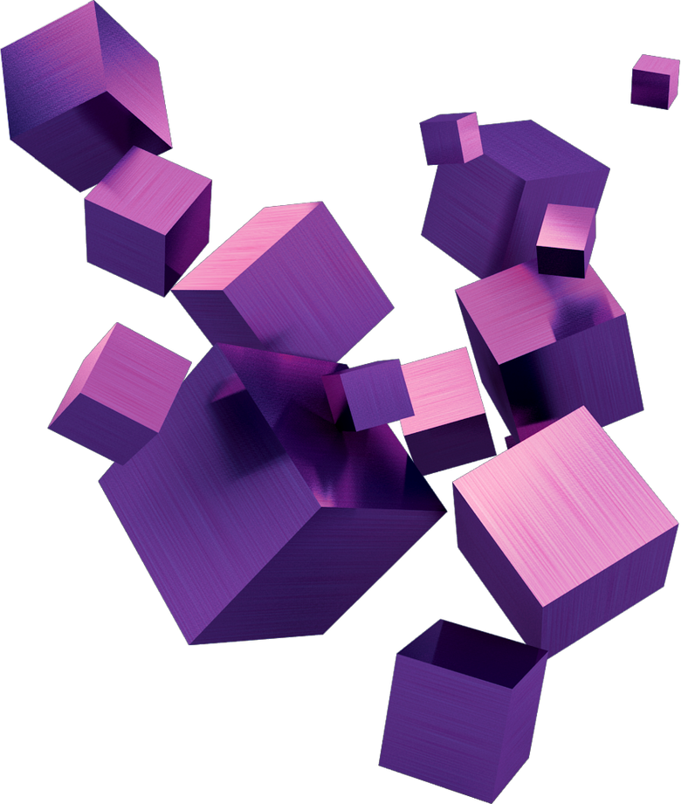

Leaves
Classification

Slide 2
INTRODUCTION

Slide 3

AIVEX TEAM
MALAK HANY
MALAK RAGAB
NADA MAHMOUD
FATEMA TAREK

Slide 4
PROBLEM STATEMENT
Problem: Manual identification of plant species is often time-consuming, requires specialized expertise, and is not easily scalable.
Need: There is a critical need for an automated, efficient, and accurate solution for plant leaf classification.
Goal: To develop and optimize a high-performing machine learning model that can correctly identify plant leaf species from real-world image data.
Impact: This solution aims to contribute to improved agricultural practices and biodiversity monitoring.

Slide 5
Imported libraries

Slide 6
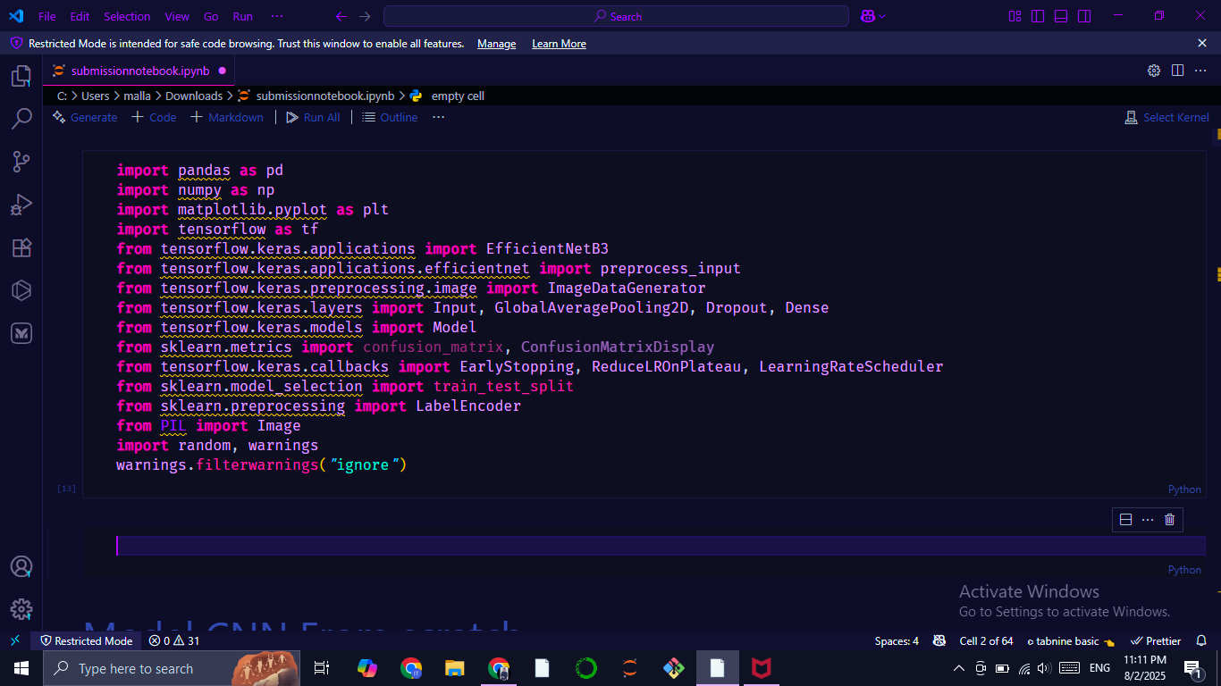
IMPORTED LIBRARIES

Slide 7
IMPORTED LIBRARIES
pandas (as pd): Used for data manipulation and analysis, especially with tabular data like CSV files.
numpy (as np): Provides support for large, multi-dimensional arrays and matrices, along with a collection of high-level mathematical functions to operate on these arrays.
matplotlib.pyplot (as plt): A comprehensive library for creating static, animated, and interactive visualizations in Python, primarily used here for plotting graphs like accuracy and loss curves, and displaying images.
tensorflow (as tf): An open-source machine learning framework used for building and training neural networks.
tensorflow.keras.applications.EfficientNetB3: Imports the EfficientNetB3 model, a pre-trained convolutional neural network architecture known for its high efficiency and accuracy, often used for transfer learning.
tensorflow.keras.applications.efficientnet.preprocess_input: A utility function specifically for preprocessing images to match the input requirements of EfficientNet models (e.g., scaling pixel values).
tensorflow.keras.preprocessing.image.ImageDataGenerator: Used for real-time data augmentation, which helps prevent overfitting by generating new training samples from existing ones through various transformations like rotation, shifting, and zooming.
tensorflow.keras.layers.Input: Used to instantiate a Keras tensor, which is the symbolic input of a Keras model or layer.
tensorflow.keras.layers.GlobalAveragePooling2D: Downsamples the spatial dimensions of its input by taking the average value over all features in a feature map. Commonly used in the head of CNNs.

Slide 8
IMPORTED LIBRARIES
tensorflow.keras.layers.Dropout: A regularization technique that randomly sets a fraction of input units to 0 at each update during training time, which helps prevent overfitting.
tensorflow.keras.layers.Dense: A fully connected neural network layer, often used as the output layer or for classification in neural networks.
tensorflow.keras.models.Model: Used to group layers into an object with training and inference features, allowing for more flexible model architectures than Sequential.
tensorflow.keras.callbacks.EarlyStopping: A callback that stops training when a monitored metric has stopped improving, preventing overfitting and saving training time.
tensorflow.keras.callbacks.ReduceLROnPlateau: A callback that reduces the learning rate when a metric has stopped improving, helping the model to converge more finely.
tensorflow.keras.callbacks.LearningRateScheduler: A callback that allows you to schedule the learning rate's value over epochs.
sklearn.model_selection.train_test_split: A function for splitting arrays or matrices into random train and test subsets.
sklearn.preprocessing.LabelEncoder: Used to encode target labels with values between 0 and n_classes-1, useful for converting categorical labels into numerical format for model training.
PIL.Image (from Pillow): A module from the Pillow library used for opening, manipulating, and saving many different image file formats.

Slide 9
IMPORTED LIBRARIES
random: Implements pseudo-random number generators for various distributions, used here for setting a seed for reproducibility.
warnings: Used to control how warnings are handled in Python, specifically to ignore them in this code.
sklearn.metrics.confusion_matrix: Computes a confusion matrix to evaluate the accuracy of a classification.
sklearn.metrics.ConfusionMatrixDisplay: Used to plot the confusion matrix.
tensorflow.keras.models.Sequential: A linear stack of layers, suitable for building simple models layer by layer.
tensorflow.keras.layers.Conv2D: A 2D convolutional layer, fundamental for image processing in CNNs.
tensorflow.keras.layers.MaxPooling2D: A pooling layer that performs max pooling operation, reducing the spatial dimensions of the output volume.
tensorflow.keras.layers.BatchNormalization: A technique for improving the training stability and performance of deep neural networks by normalizing the inputs of layers.
tensorflow.keras.layers.LeakyReLU: An activation function that allows a small, non-zero gradient when the input is negative, potentially preventing "dying ReLUs".

Slide 10
Dataset
Data preprocessing

Slide 11
Dataset description
Total Samples: 5,262 images
Image Format: JPG & RGB color space ( 3 channels )
Capture Style: Natural environment photography, with a mix of clean and cluttered backgrounds
Leaf Presentation: Leaves appear in various orientations and lighting conditions, emulating real-world variability

Slide 12
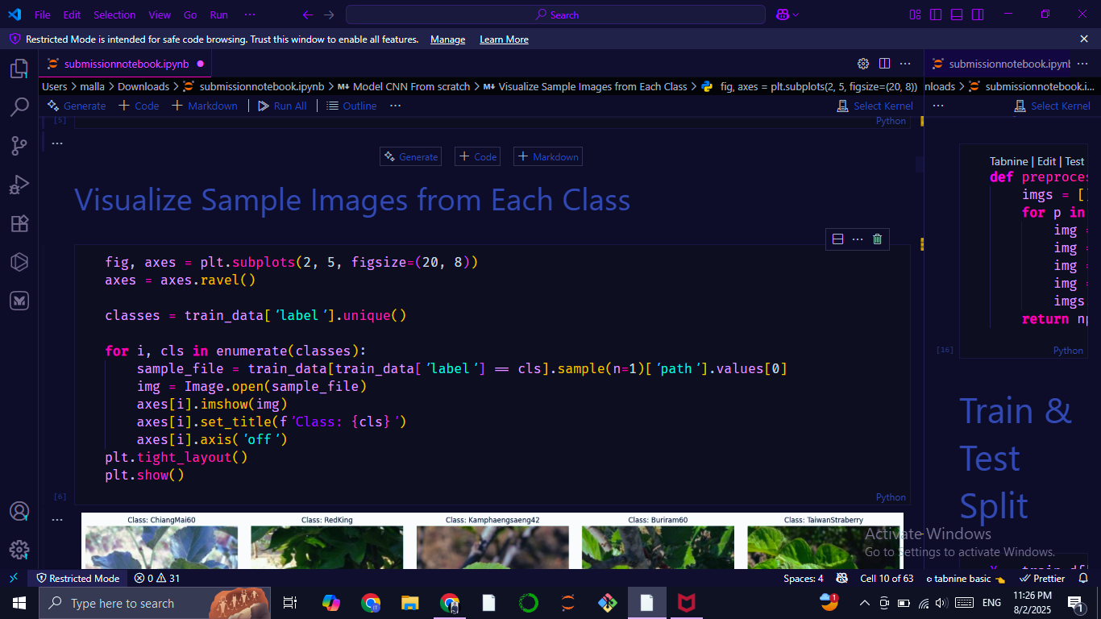
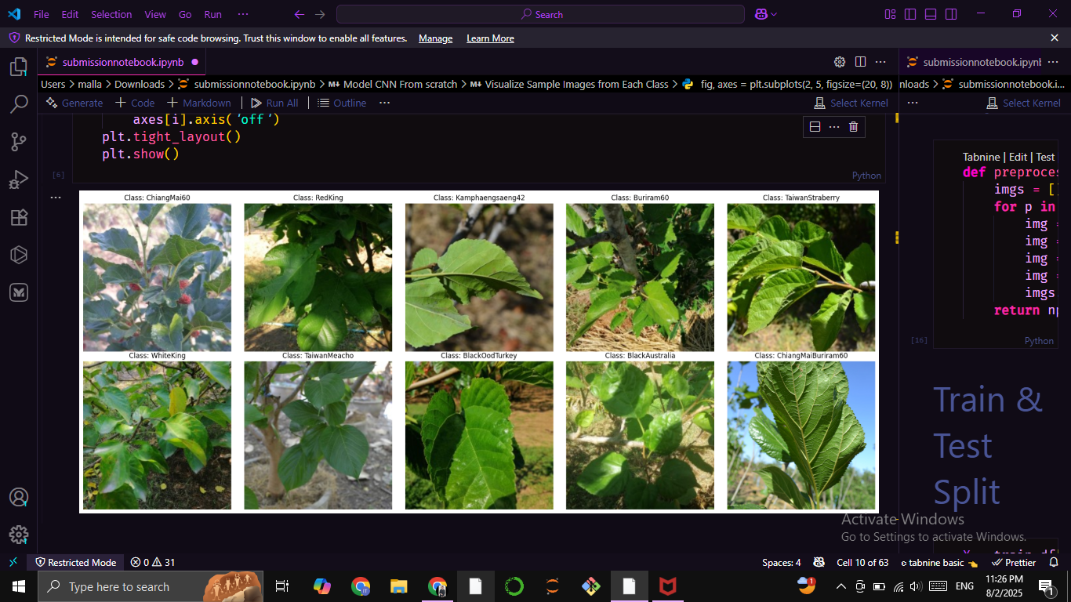
Visualize Sample Images from Each Class

Slide 13
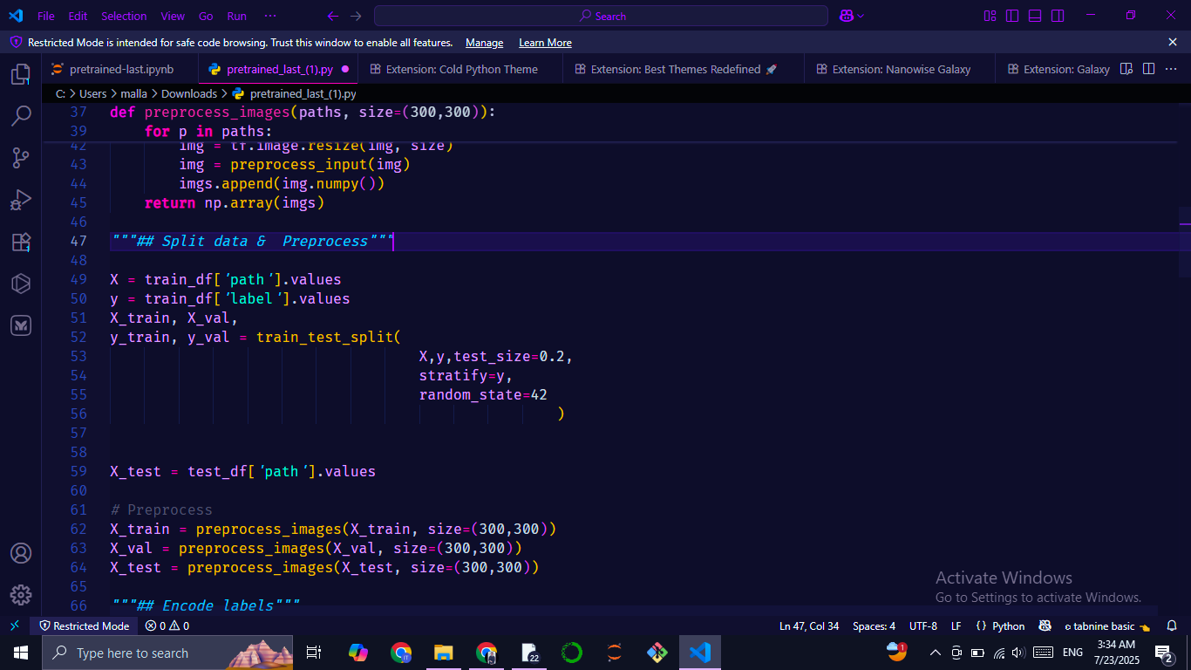
Data Splitting
Training Set: Labeled images across all 10 classes for supervised model training
Validation Set: Held-out samples used for tuning hyperparameters
Test Set: Final evaluation set with hidden labels to assess generalization

Slide 14
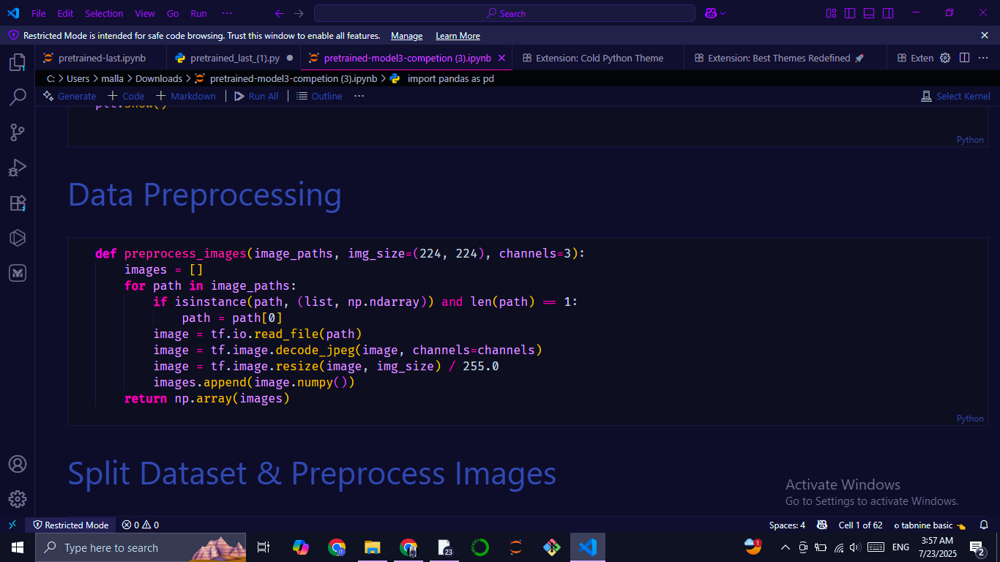
Image Preprocessing Function:
Reads each image
Decodes it to RGB
Resizes to 224×224
Scales pixel values to [0, 1] range

Slide 15
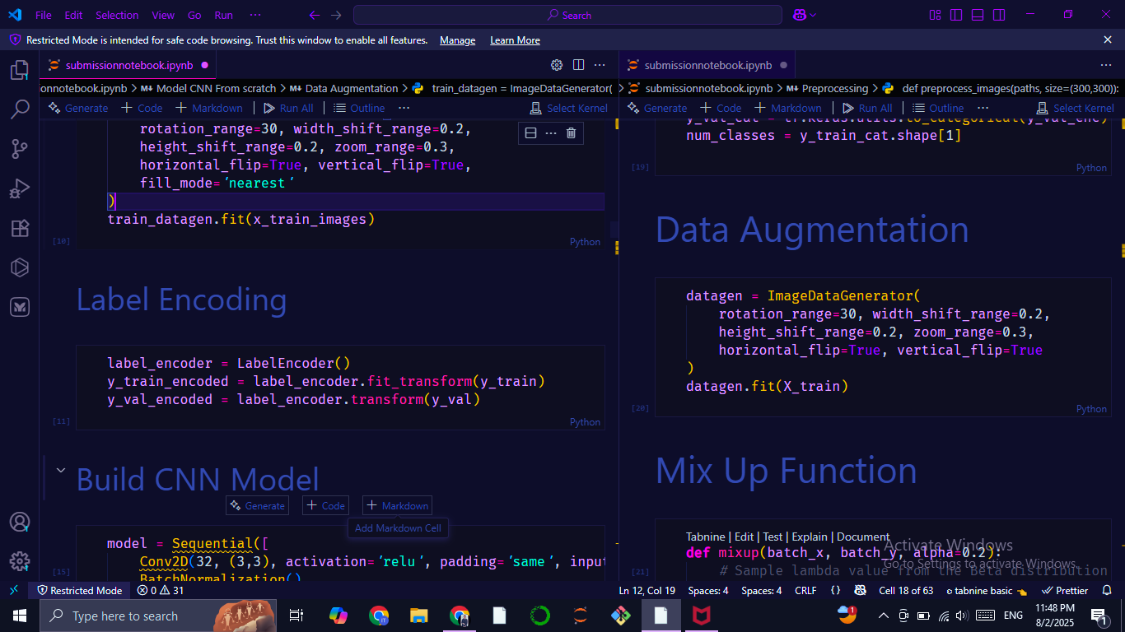
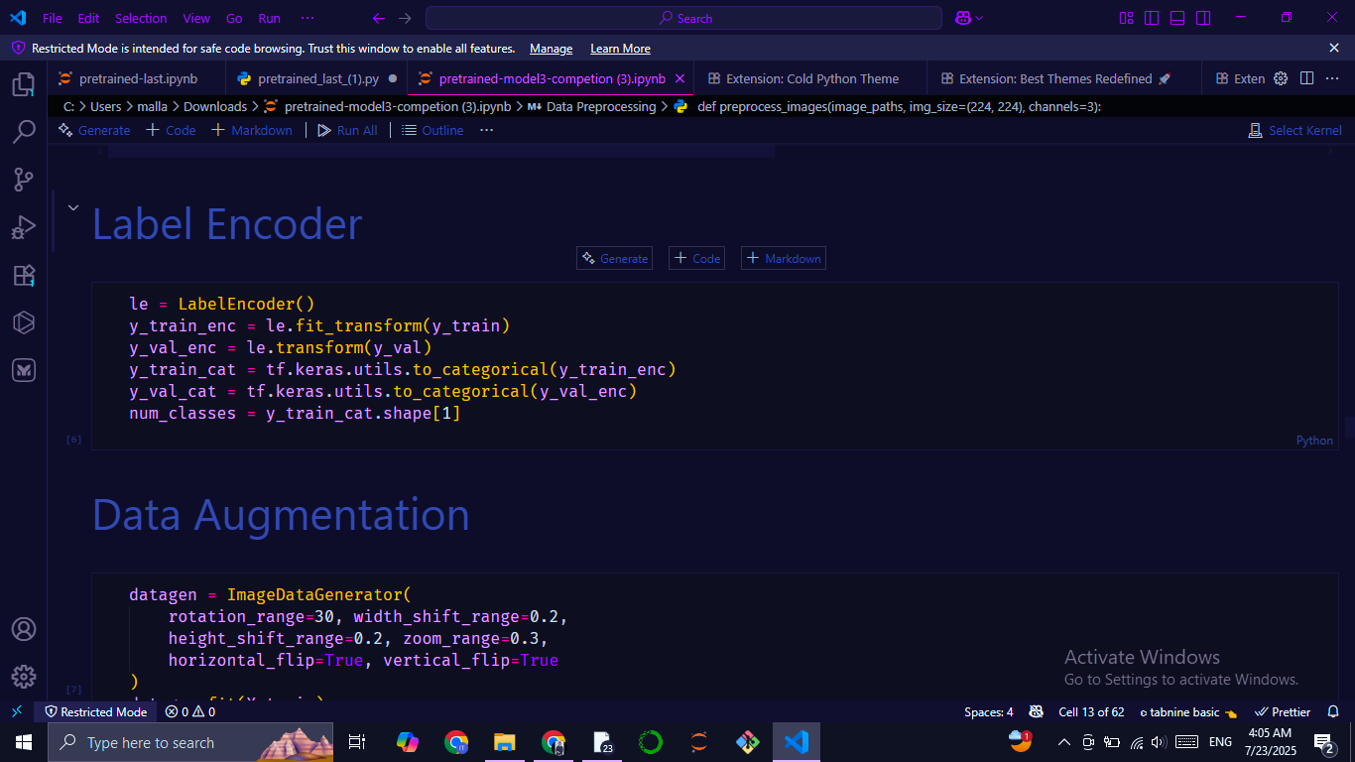
Label encoding
Model from scratch
Pretrained model
Transformed class labels from strings to integers using LabelEncoder for model from scratch and one hot encoding for pretrained model

Slide 16
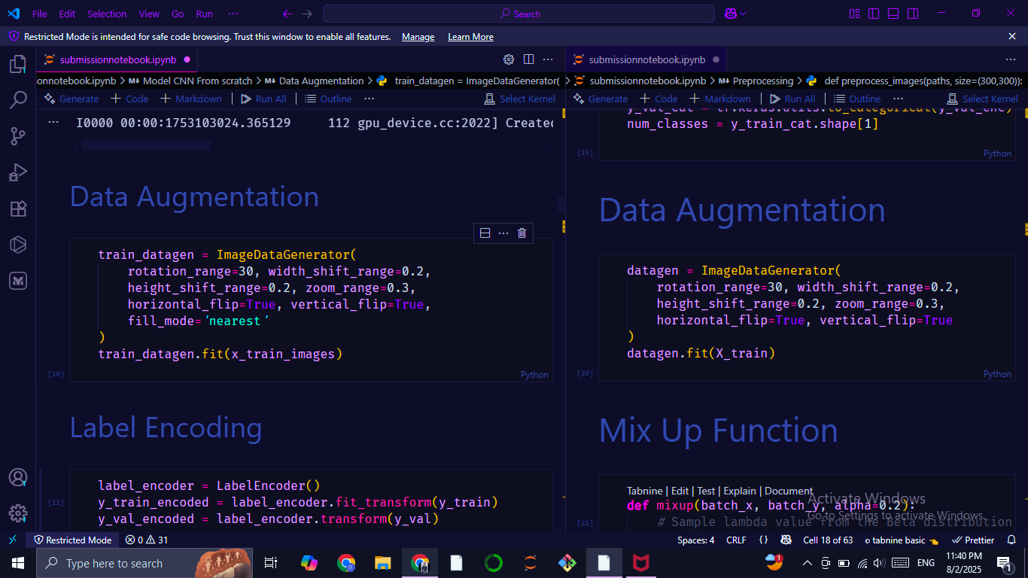
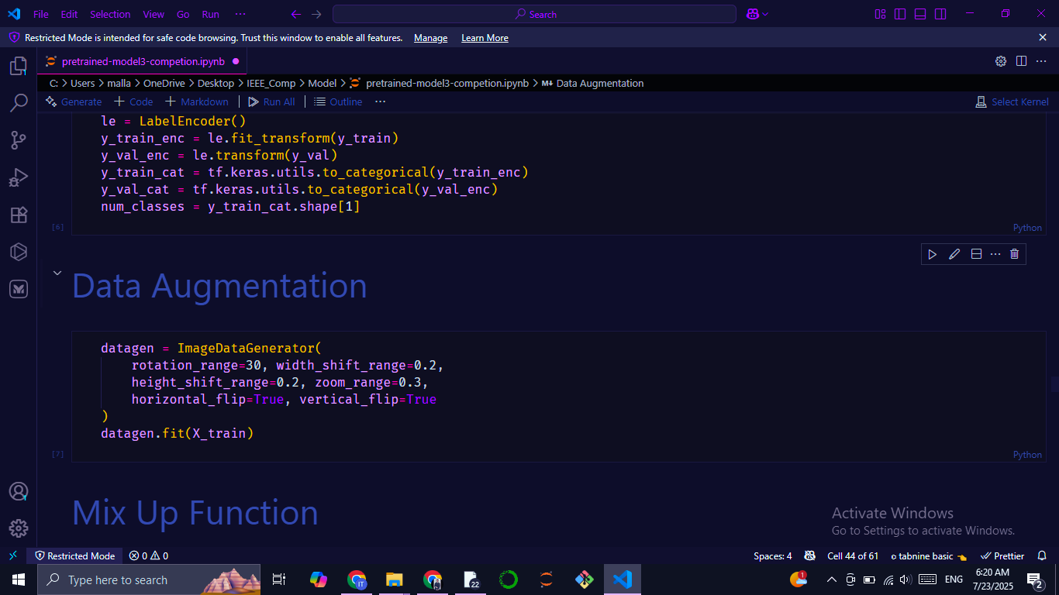
Data Augmentation
Randomly rotate images up to 30°
Shift image horizontally by 20%
Shift image vertically by 20%
Random zoom in/out by 30%
Random horizontal flip
Random vertical flip
Fill mode nearest
Model from scratch
Pretrained model

Slide 17
approach, architecture and design

Slide 18
Custom CNN model
(Model from scratch)

Slide 19
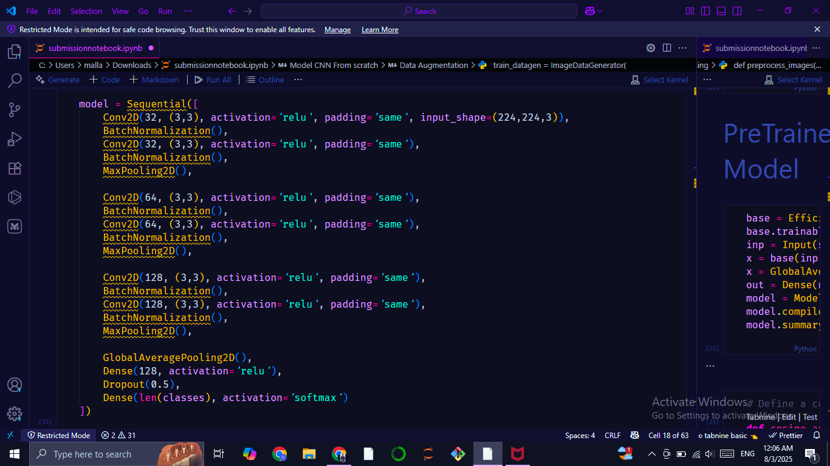
CUSTOM CNN MODEL
3 convolutional blocks with increasing filters (32 → 64 → 128) ReLU activation, padding same, each followed by batch normalization for improving training stability and max pooling.
Global average pooling (flatten), dense layer with dropout for regularization, and softmax output for multi-classification to generate class probabilities

Slide 20
Pretrained model
(transfer learning)

Slide 21
TRANSFER LEARNING
EFFICIENTNETB3
Leveraged EfficientNetB3, a state-of-the-art CNN pretrained on ImageNet (~1,000 classes)
Delivers strong accuracy–efficiency trade-off, ideal for image classification tasks
Pretraining enables robust feature transfer, especially effective for limited data scenarios

Slide 22
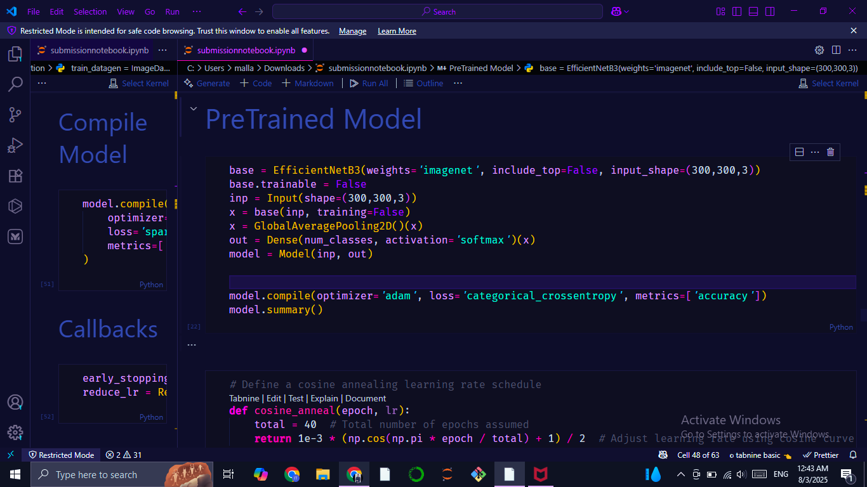
CUSTOMIZING EFFICIENTNETB3 FOR OUR TASK
Base Model: EfficientNetB3 with pretrained ImageNet weights
Modification: Replaced original 1000-class output with Dense(num_classes, activation='softmax')
Purpose: Tailored the model to classify our specific leaf types (10 classes)

Slide 23
Training Setup

Slide 24
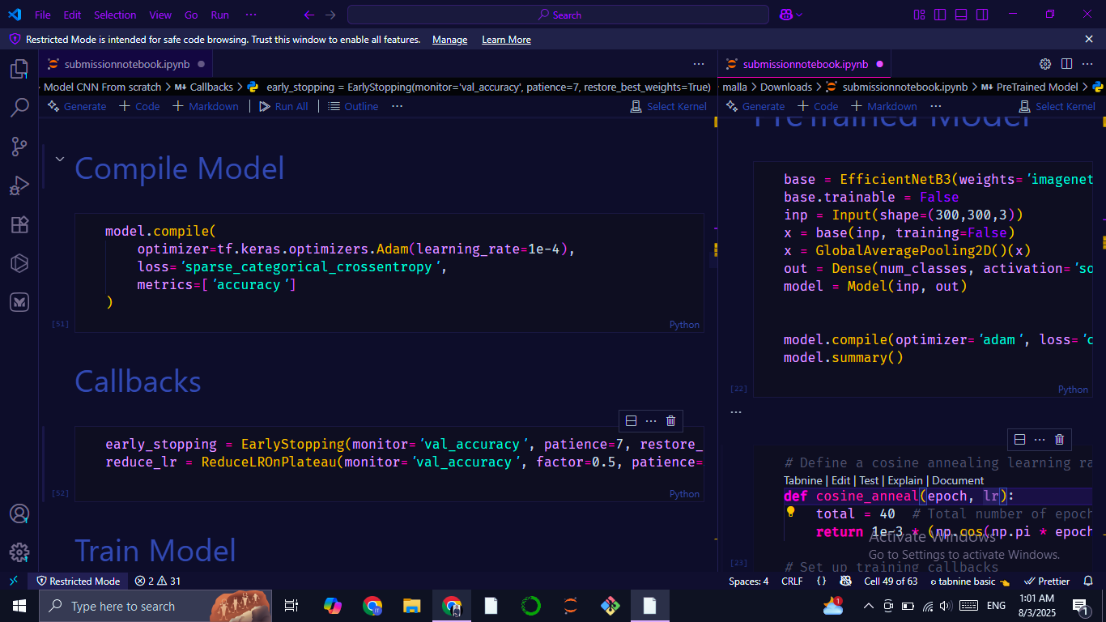
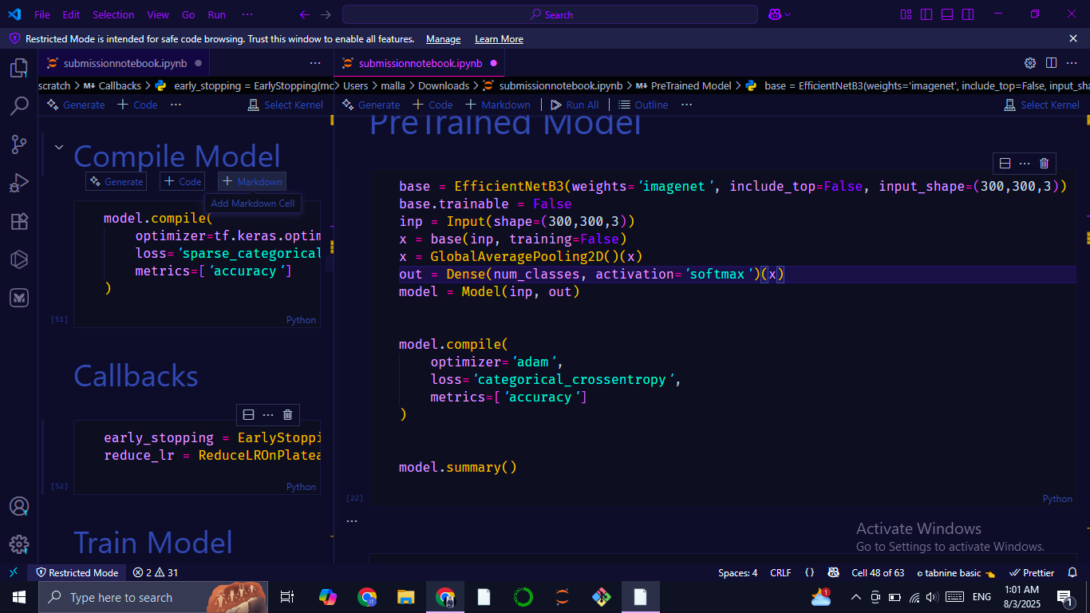
Compile Step
Model from scratch
Optimizer: adam
metrics: accuracy
Loss: categorical_crossentropy (pretrained) & sparse_categorical_crossentropy (scratch)
Pretrained model

Slide 25
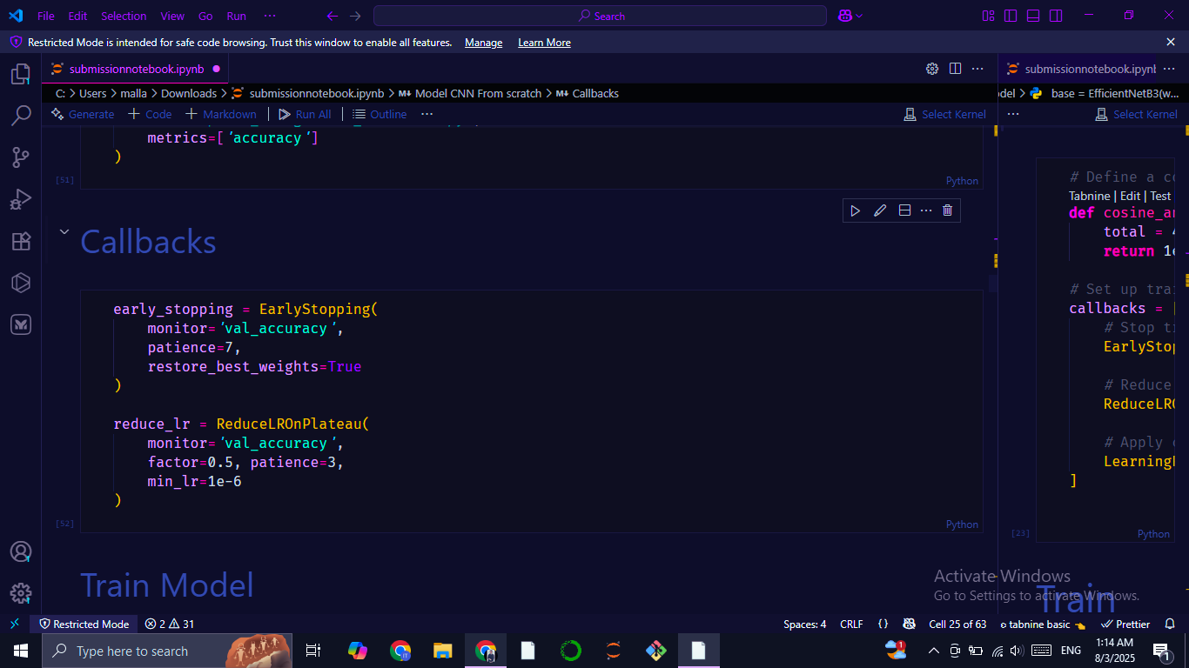
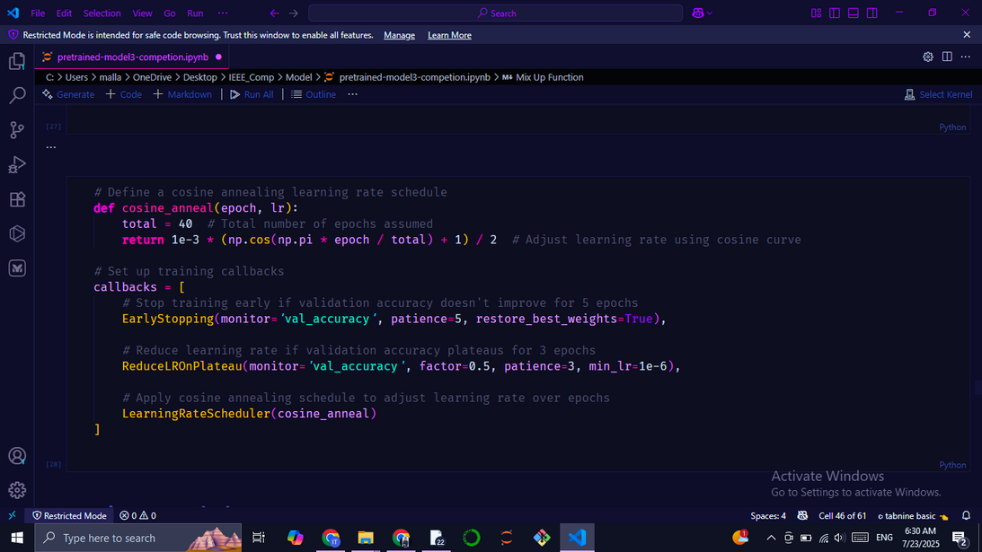
Callbacks & cosine annealing learning rate
Model from scratch
Pretrained model
EarlyStopping: Prevents overfitting by halting when accuracy stops improving
ReduceLROnPlateau: Dynamically reduces learning rate on plateaus
Cosine Annealing Scheduler: Smoothly decays learning rate over epochs for better convergence (pretrained)

Slide 26
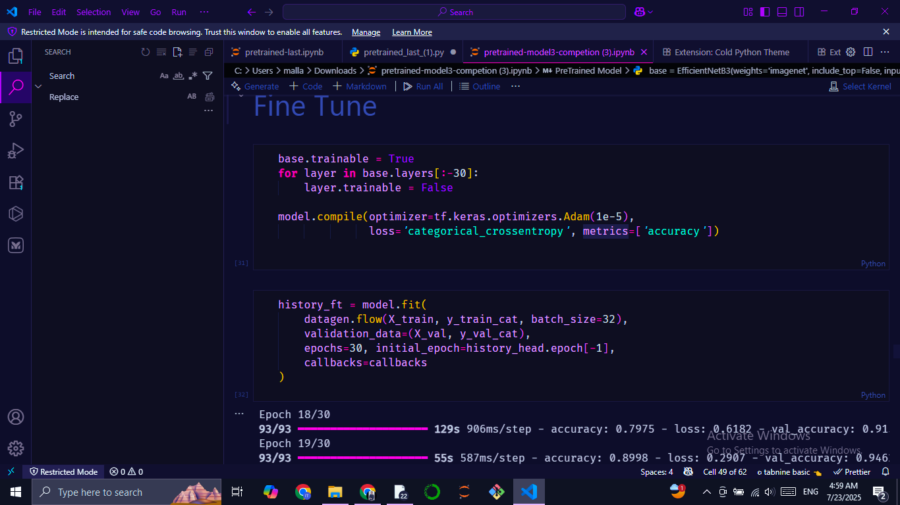
Fine-Tuning:
Pretrained model
Pretrained model
Fine-tuned it to classify a smaller, domain-specific dataset (Mulberry leaf species)
Unfroze last 30 layers of the base model
Used lower learning rate
Continued training from the last epoch

Slide 27
Visualization Evaluation

Slide 28
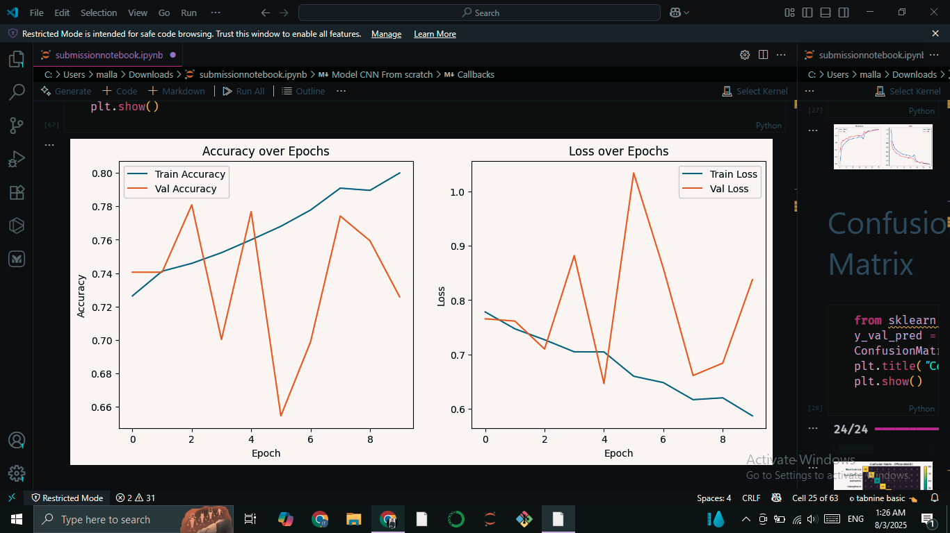
From scratch model

Slide 29
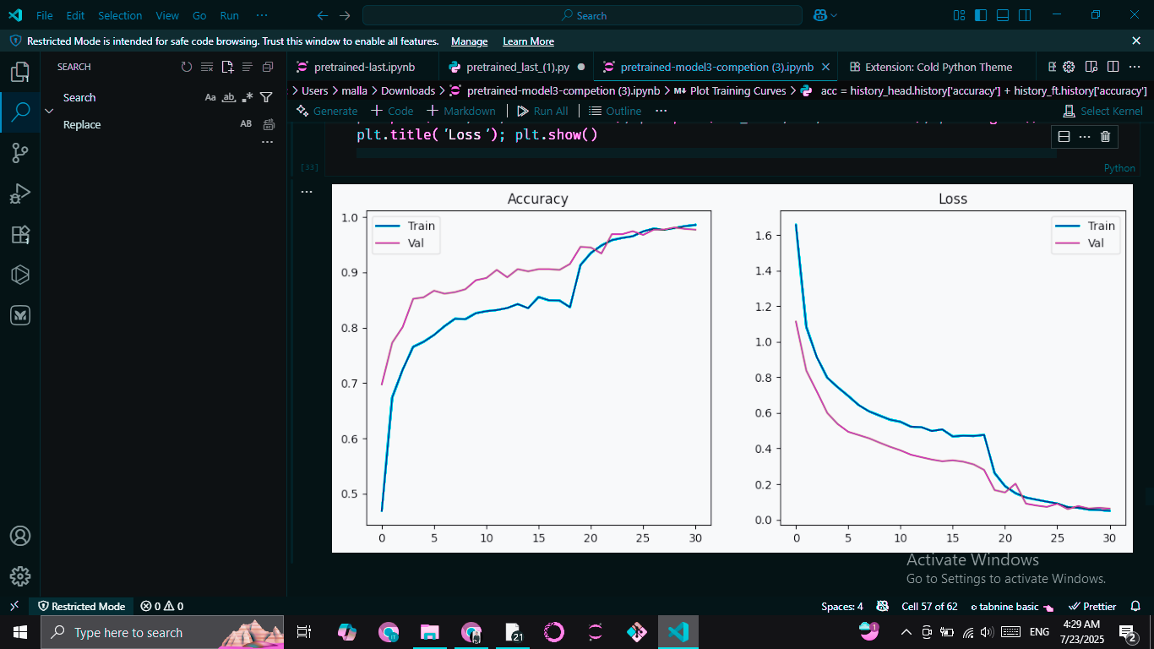
Pretrained model

Slide 30
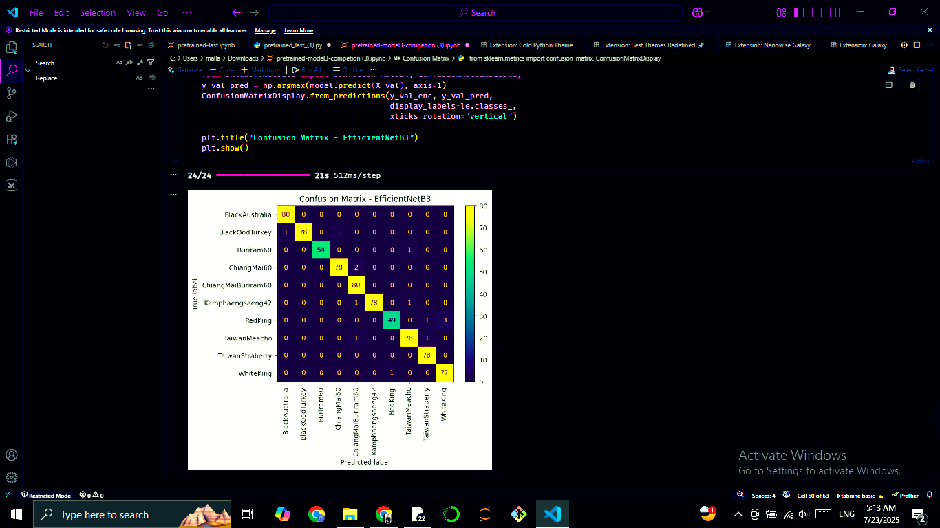
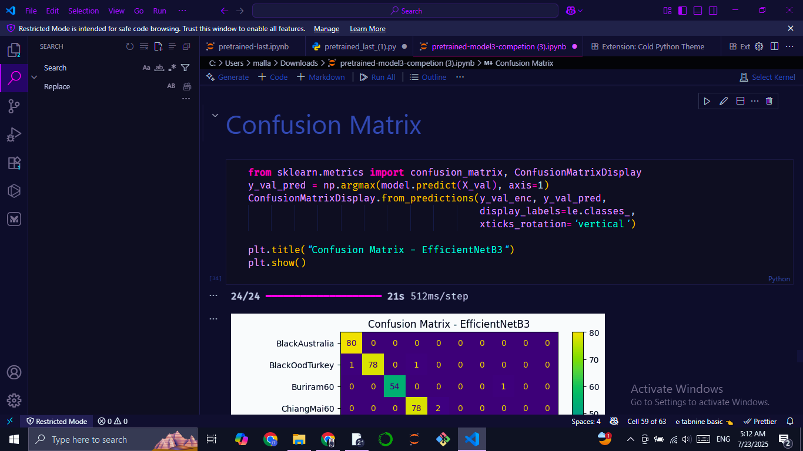
Confusion
Matrix
Pretrained model

Slide 31
Models Compareson

Slide 32
Aspect | Model From Scratch | Pretrained Model
Architecture | Custom CNN (manually defined Conv & Dense layers) | Transfer learning using a pretrained base
Accuracy | Lower validation/test accuracy | Higher validation/test accuracy
Overfitting | More prone to overfitting | Less prone to overfitting
Data Efficiency | Needs more data to generalize well | Performs well even with smaller datasets

Slide 33
CONCLUSION
Custom CNN Model (from Scratch):
Designed a compact architecture with 3 convolutional blocks, each using 'same' padding, ReLU activation, BatchNormalization, and MaxPooling.
Final layers include GlobalAveragePooling, Dropout, and a softmax classifier.
Pretrained Model (EfficientNetB3):
Utilized a high-performing pretrained CNN for efficient feature extraction, with a customized output layer adapted to our leaf classification task.
Integrated BatchNormalization and advanced data augmentation techniques to enhance performance and improve generalization.
Resulted in a lightweight, accurate, and robust model suitable for real-world deployment.

Slide 34

THANK YOU
OPEN FOR ALL YOUR QUESTIONS!

